Slide 1
Indirect or community effect and prioritization of malaria interventions
PhD Update
Nov 2025

Slide 2
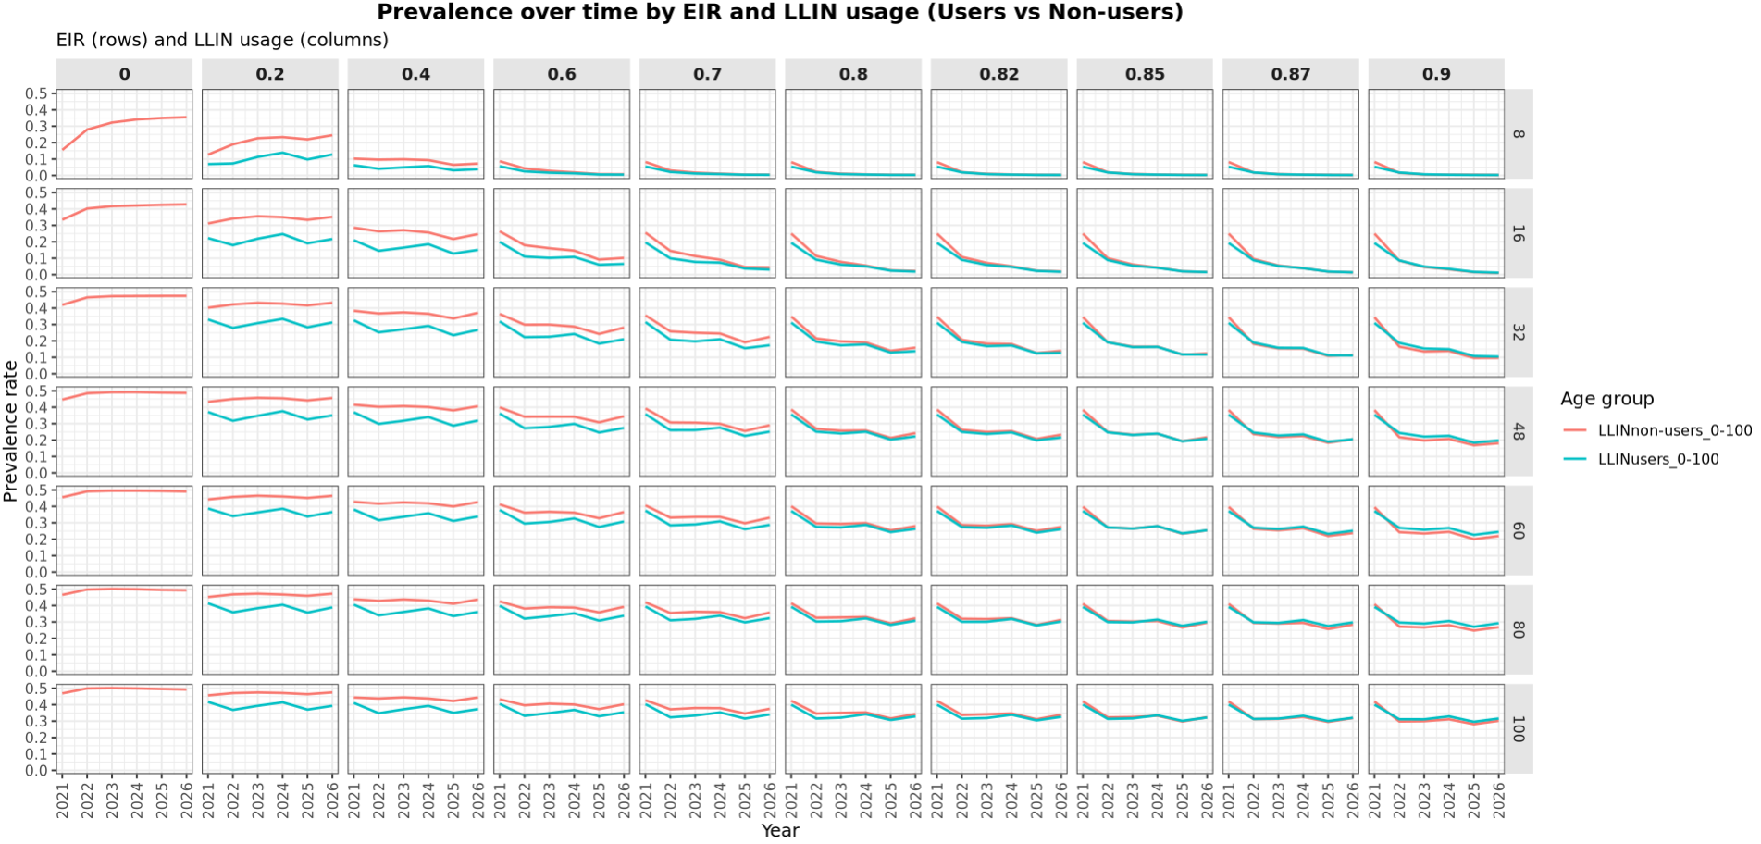
Results: plot of malaria prevalence in users and non-users by usage and EIR
Notes:
Showing prevalence over time after LLIN deployments

Slide 3
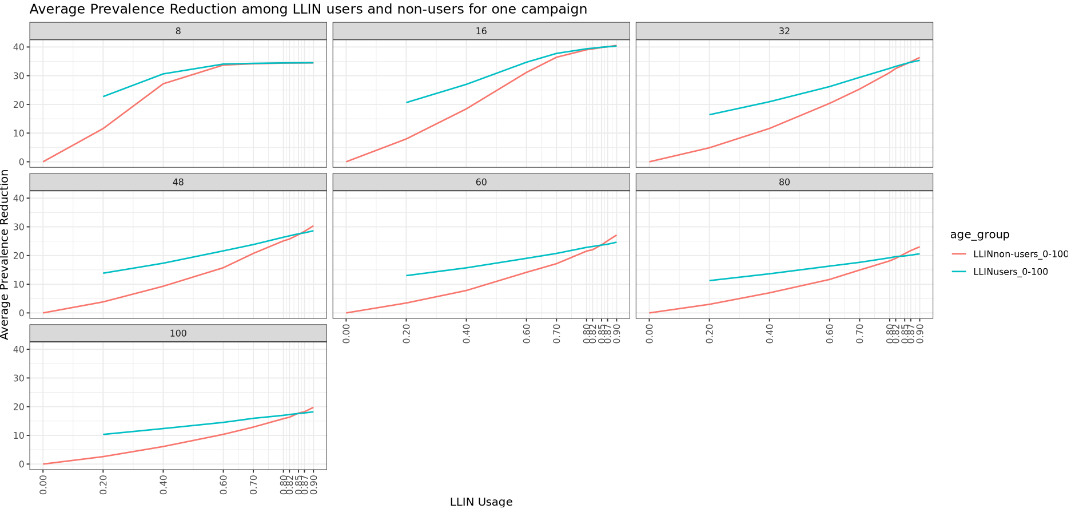
Results: plot of average malaria prevalence reduction in users and non-users by usage and EIR

Slide 4
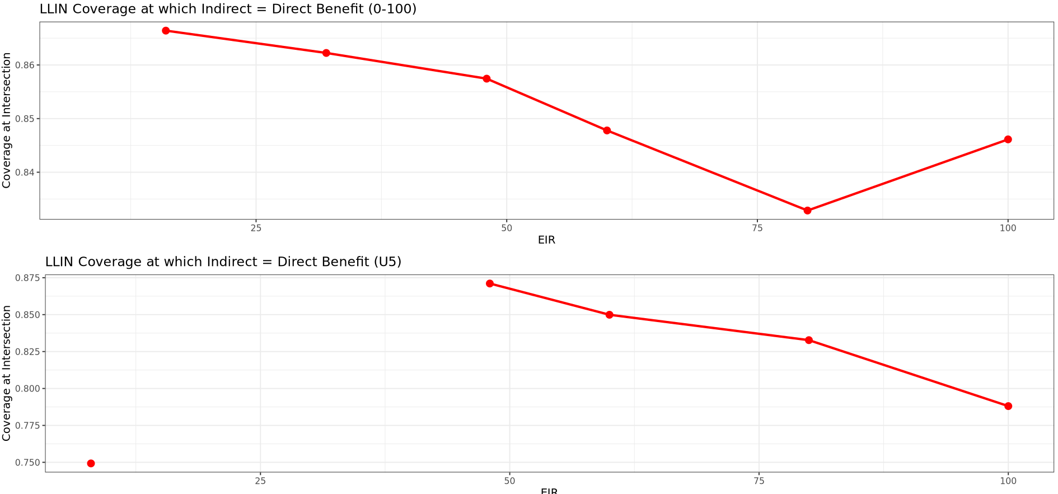
Results: plot of LLIN usage level at which indirect = direct benefit – (0-100)

Slide 5
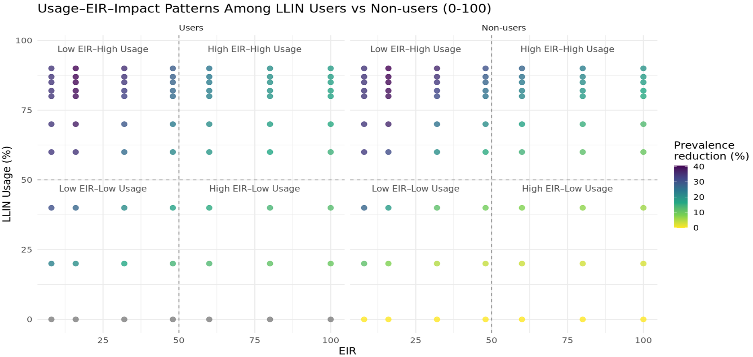
Results: plot of average malaria prevalence reduction in LLIN users and non-users by usage and EIR – (0-100)
1
2
3
4

Slide 6
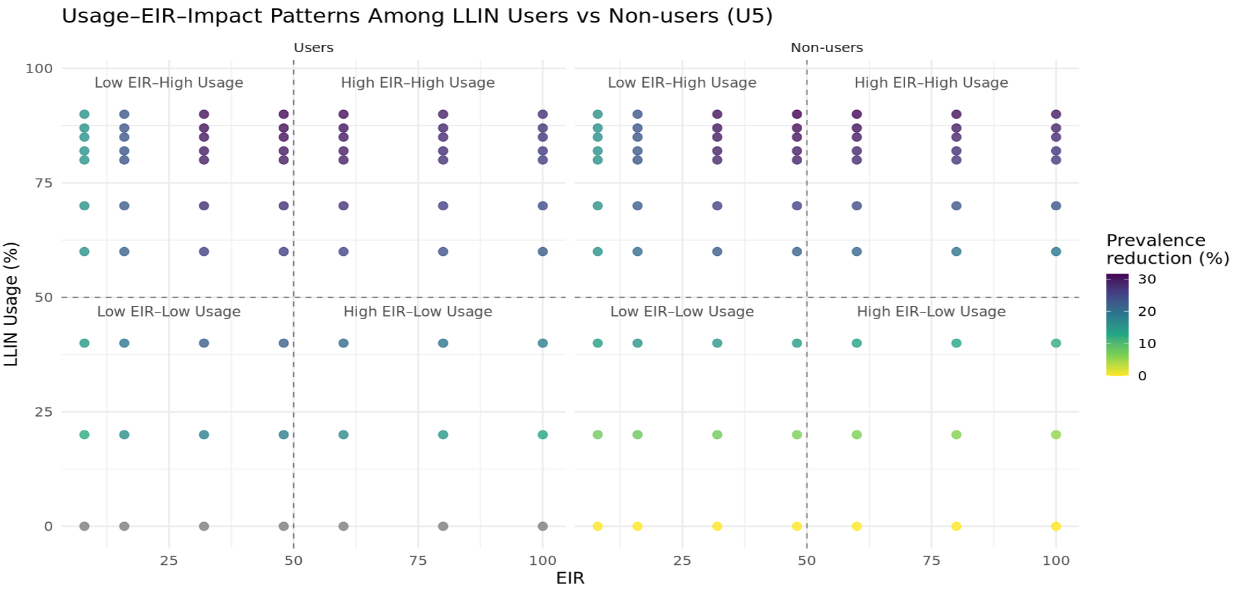
Results: plot of average malaria prevalence reduction in LLIN users and non-users by usage and EIR – U5s
2
1
3
4

Slide 7
SMC

Slide 8
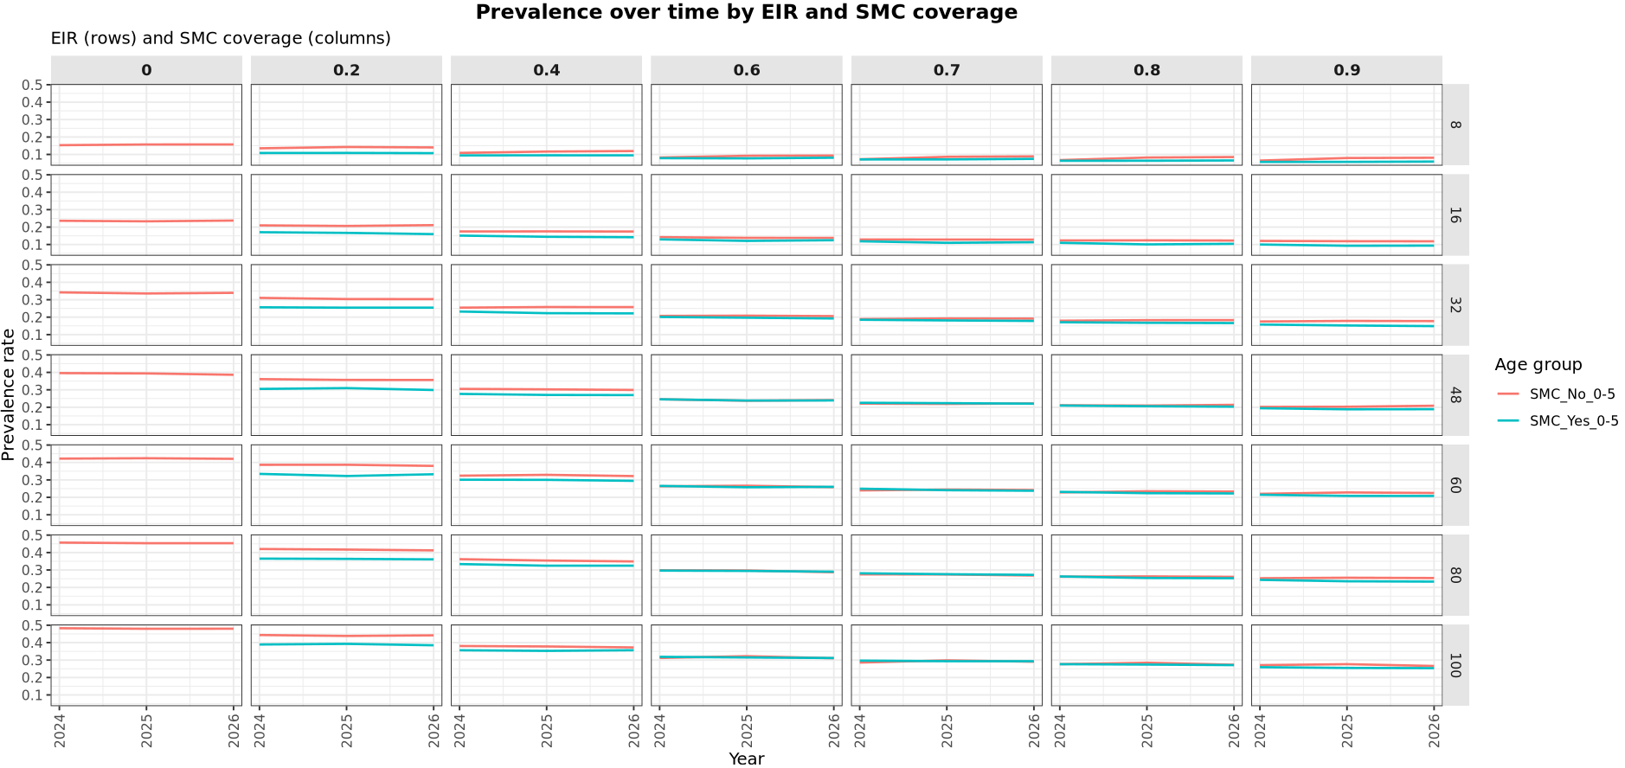
Results: plot of malaria prevalence in SMC recipients and non- recipients by coverage and EIR – U5s

Slide 9
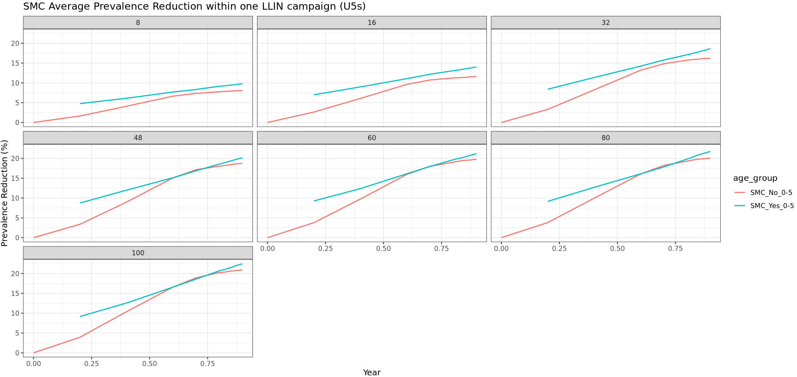
Results: plot of average malaria prevalence reduction in SMC recipients and non- recipients by coverage and EIR – U5s
Coverage
Notes:
60% SMC cov benefits non-recipients equally in high transmission settings
There is no intersection in low EIR settings

Slide 10
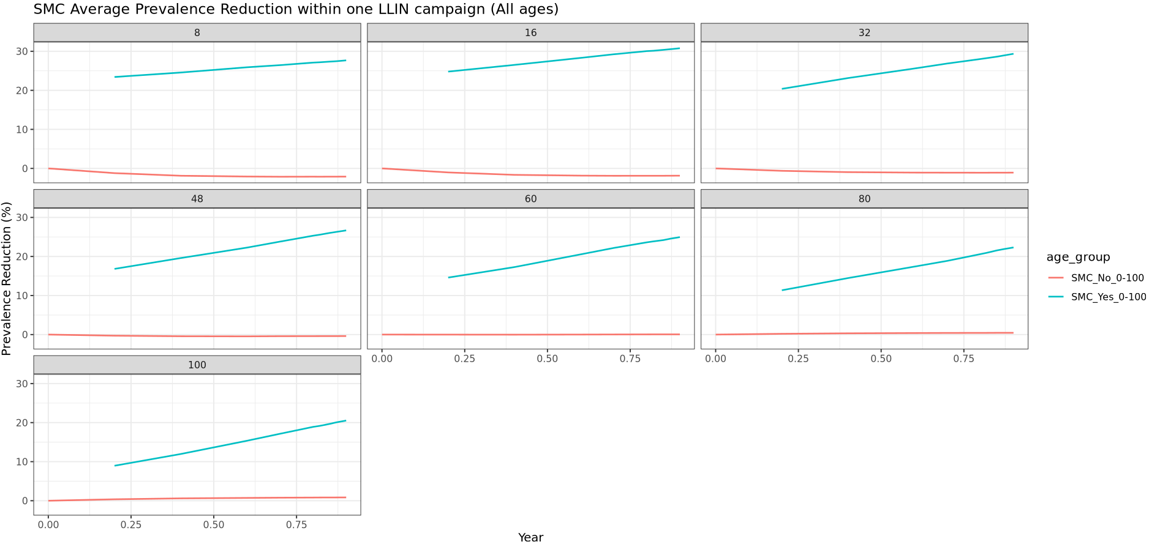
Results: plot of average malaria prevalence reduction in SMC recipients and non- recipients by coverage and EIR – 0-100
Coverage
Notes:
60% SMC cov benefits non-recipients equally in high transmission settings
There is no intersection in low EIR settings

Slide 11
Vaccine

Slide 12
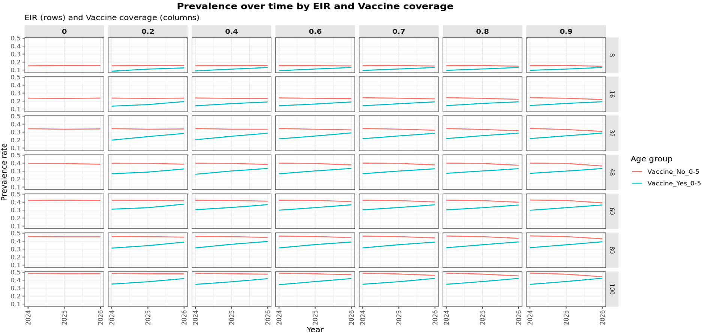
Results: plot of malaria prevalence in vaccine recipients and non- recipients by coverage and EIR – (U5)
Notes:
Non-users do not benefit from vaccine even on U5s

Slide 13
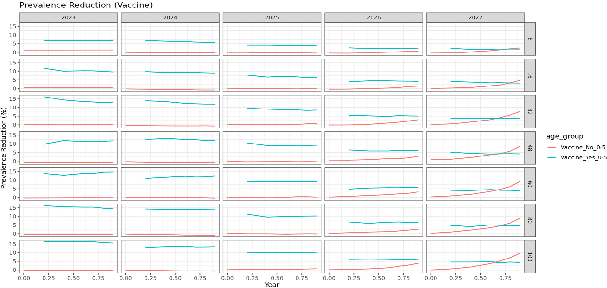
Results: plot of malaria prevalence in vaccine recipients and non- recipients by coverage and EIR – (U5)
Coverage
Notes:
Non-users do not benefit from vaccine even on U5s

